Slide 1
What is DHT?

Slide 2
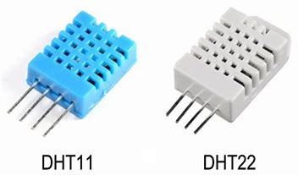
INTRODUCTION
DHT is basically Temperature & Humidity sensor. The DHT sensors are made of two parts, a capacitive humidity sensor and a thermistor. We have a two versions of the DHT sensor and they are;
DHT11
DHT22

Slide 3
Introduction
DHT11 Temperature & Humidity Sensor feature a temperature & humidity signal acquisition complex with a calibrated digital signal output. By using the exclusive digital-signal-acquisition technique and temperature & humidity sensing technology, it ensures high reliability and excellent long term stability. This sensor include a resistive type humidity measurement component and a NTC temperature measurement component, connect to a high performance 8-bit microcontroller, offering excellent quality, face response, anti-interface ability and cost effectiveness. It’s of small size, low power consumption and up to 20 m signal transmission makes it a best choise for various applications.

Slide 4
Features
DHT series digital temperature & humidity sensor.
Full range of calibration, in-line digital output;
Humidity measuring range:20% to 90% RH
Temperature measuring range:0 to 50 0C;
Humidity measurement accuracy: 5.0% RH
Temperature measurement accuracy: 2.0
Low power consumption.
Power:3.5 -5V.
The sampling period of the sensor is 1 second.

Slide 5
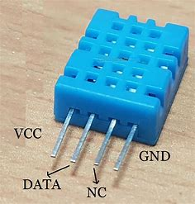
DHT11 SENSOR
DHT11 sensor consists of 4 pins:
VCC
Data
Not Connected(NC)
GND.
The range of voltage for VCC pin is 3.5V to 5.5V. A 5V supply would do fine.
The data from the Data Out pin is a serial digital data.
The data from the sensor consists of integral and decimal parts for both Relative Humidity(RH) and temperature.
The data from the DHT11 sensor consists of 40- bits and the format is as follow:
8-Bit data for integral RH value, 8-Bit data for decimal RH value, 8-Bit data for integral Temperature value, 8-Bit data for decimal Temperature value, 8-Bit data for checksum.

Slide 6
Example
Consider the data received from the DHT11 sensor is;
00100101 00000000 00011001 00000000 00111110.
In order to check whether the received data is correct or not, we need to perform a small calculation. Add all the integral and decimals values and check whether the sum is equal to the checksum value i.e. the last 8-bit data.
00100101+00000000+00011001+00000000 =00111110
The value is same as checksum and hence the received data is valid. Now to get RH and Temperature values, just convert the binary data to decimal data.
RH= Decimal of 00100101= 37%
Temperature = Decimal of 00011001= 25 0C

Slide 7
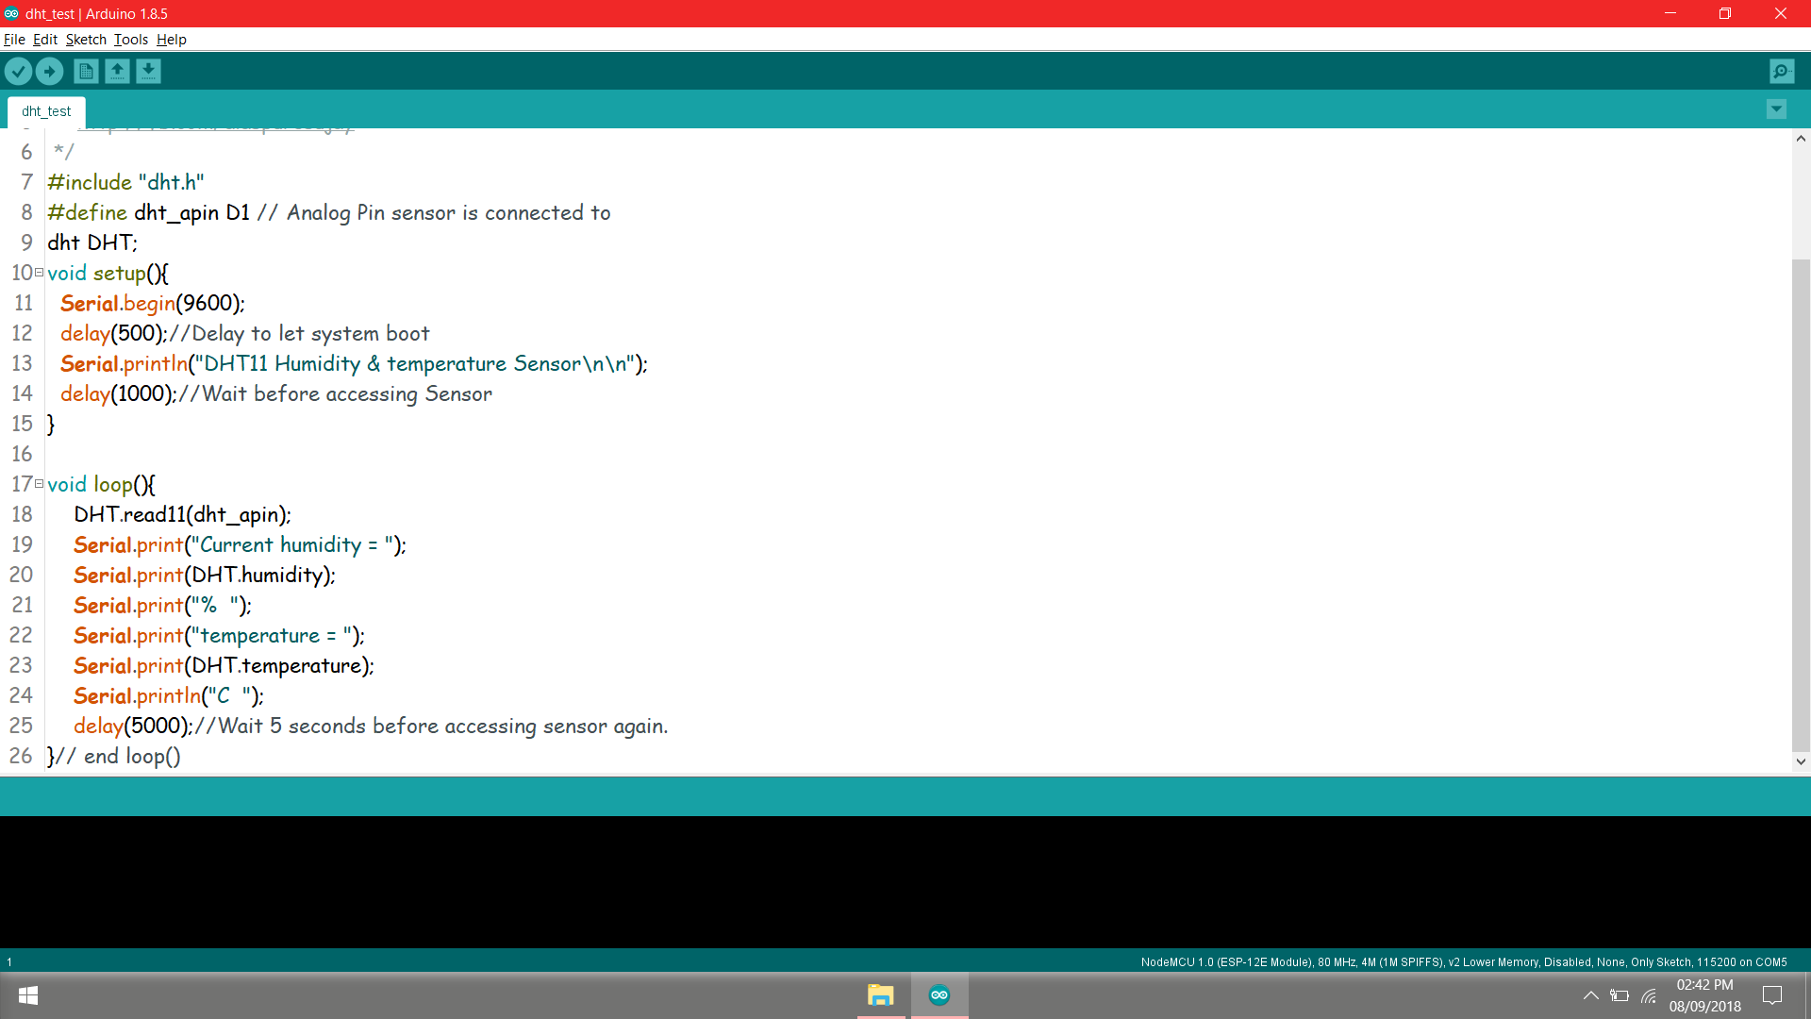
Interfacing With Board And Reading Value

Slide 8
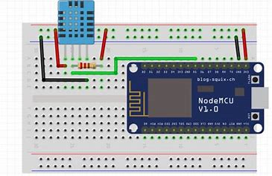
Circuit Diagram

Slide 9
Application
DHT11 Relative Humidity and Temperature sensor can be used in many applications like;
HVAC(Heating, Ventilation and Air conditioning) system.
Weather Stations.
Medical Equipment for measuring humidity.
Home Automation systems.
Automotive and other weather control applications.

Slide 10
Advantages
It does not require any maintenance for longer periods.
Flexibility to use.
Low cost.
Atm. Pressure independent, it work when pressure is being applied.

Slide 11
Disadvantage
Some time it quite slow.

